Slide 1
Automating front-end tests with cypress.io: A hands-on course
Rafael Silva
Software Tester
Notes:
Den här mallen kan användas som en startfil för att presentera utbildningsmaterial i en grupp.
Avsnitt
Högerklicka på en bild om du vill lägga till avsnitt. Avsnitt gör det lättare att ordna bilder och att samarbeta med andra författare.
Anteckningar
Använd avsnittet Anteckningar för leveransanteckningar, eller om du vill ge åhörarna mer detaljerad information. Visa de här anteckningarna i presentationsvyn under presentationen.
Var noggrann när du väljer teckenstorlek (storleken är viktig för hjälpmedelsfunktioner, synlighet, videoinspelning och onlineproduktion)
Koordinerade färger
Var särskilt noggrann med diagram och textrutor.
Tänk på att deltagarna kan välja att skriva ut i svartvitt eller gråskala. Gör en testutskrift och kontrollera att färgerna ser bra ut även om de skrivs ut i svartvitt eller gråskala.
Grafik, tabeller och diagram
Enkelhet är ofta bäst: använd konsekventa, icke-distraherande stilar och färger, så långt det är möjligt.
Märk alla diagram och tabeller med etiketter.

Slide 2
Agenda – day 2
Introduction to cypress.io
Introduction to css selectors
Setting-up cypress.io
Cypress.io practice
Exercises

Slide 3
Introduction to cypress.io
Created by Brian Mann.
A testing tool created entirely in javascript.
Has a command line utility, which makes it possible to run scripts in build servers, e.g. jenkins, teamcity, etc.
The Test Runner (The desktop application) is free, downloadable and open-source.
The Dashboard Service is a web application that offers different plans for you keep track of your test runs in CI.
Has support for Mac, Linux and Windows.
Has support for both headless run and run on the supported browsers.
Generates a video recording out of test runs without requiring installations of third-party libraries or tools.
A short introduction to cypress by Brian Mann: https://www.youtube.com/watch?v=pJ349YntoIs

Slide 4
Introduction to cypress.io
Overall performance is faster when compared to other tools, such as Selenium Webdriver, Robotframework, etc.
Browser support is limited to chrome-based browsers, i.e. Electron, Chromium, Chrome and Canary.

Slide 5
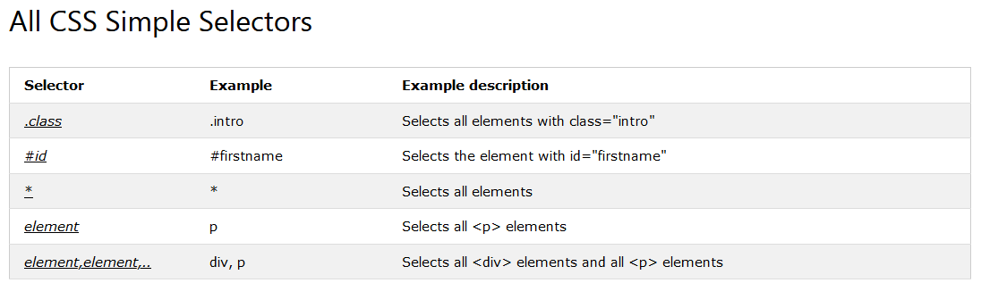
Introduction to CSS and CSS Selectors
CSS (Cascading style sheets)
A language used for style of an HTML document.
CSS provide means for identification of elements through selectors.
You can use CSS selectors for accessing elements with cypress
https://www.w3schools.com/css/css_selectors.asp

Slide 6
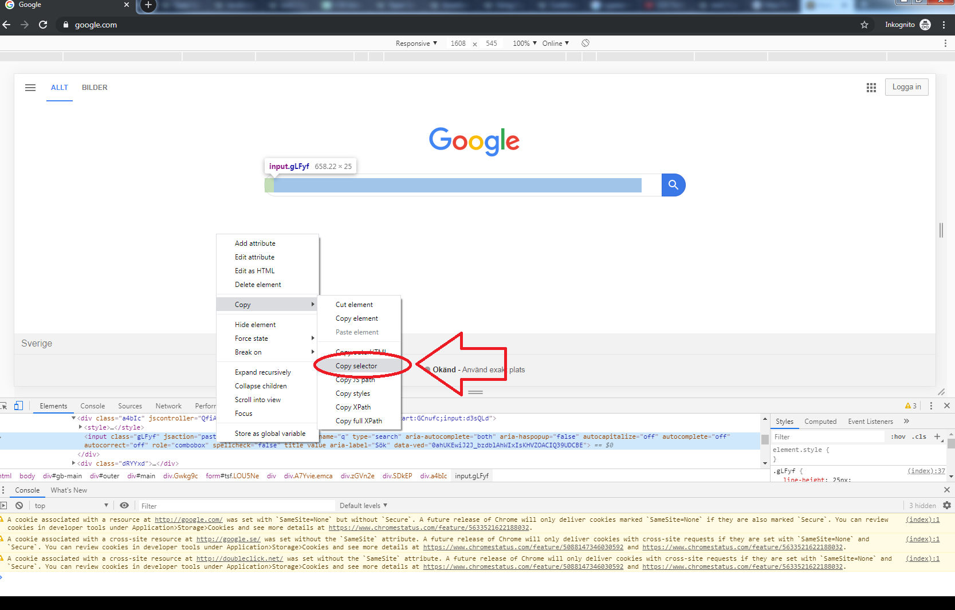
Introduction to css selectors
Inspector / Devtools

Slide 7
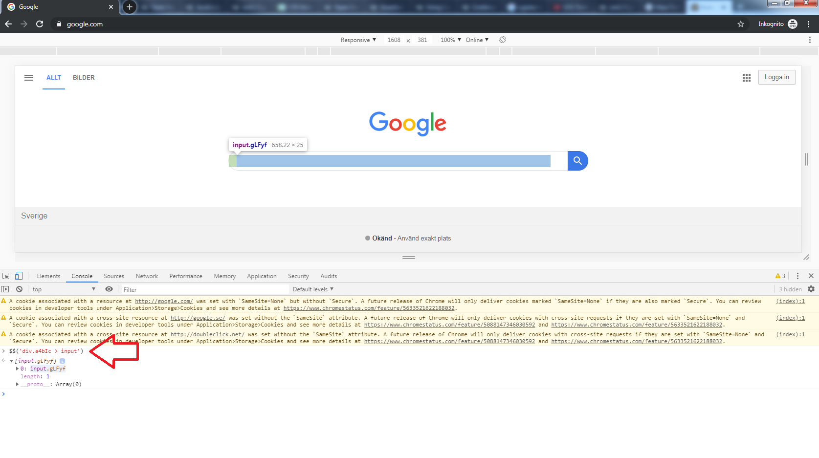
Introduction to css selectors
Using the console on the devtools

Slide 8
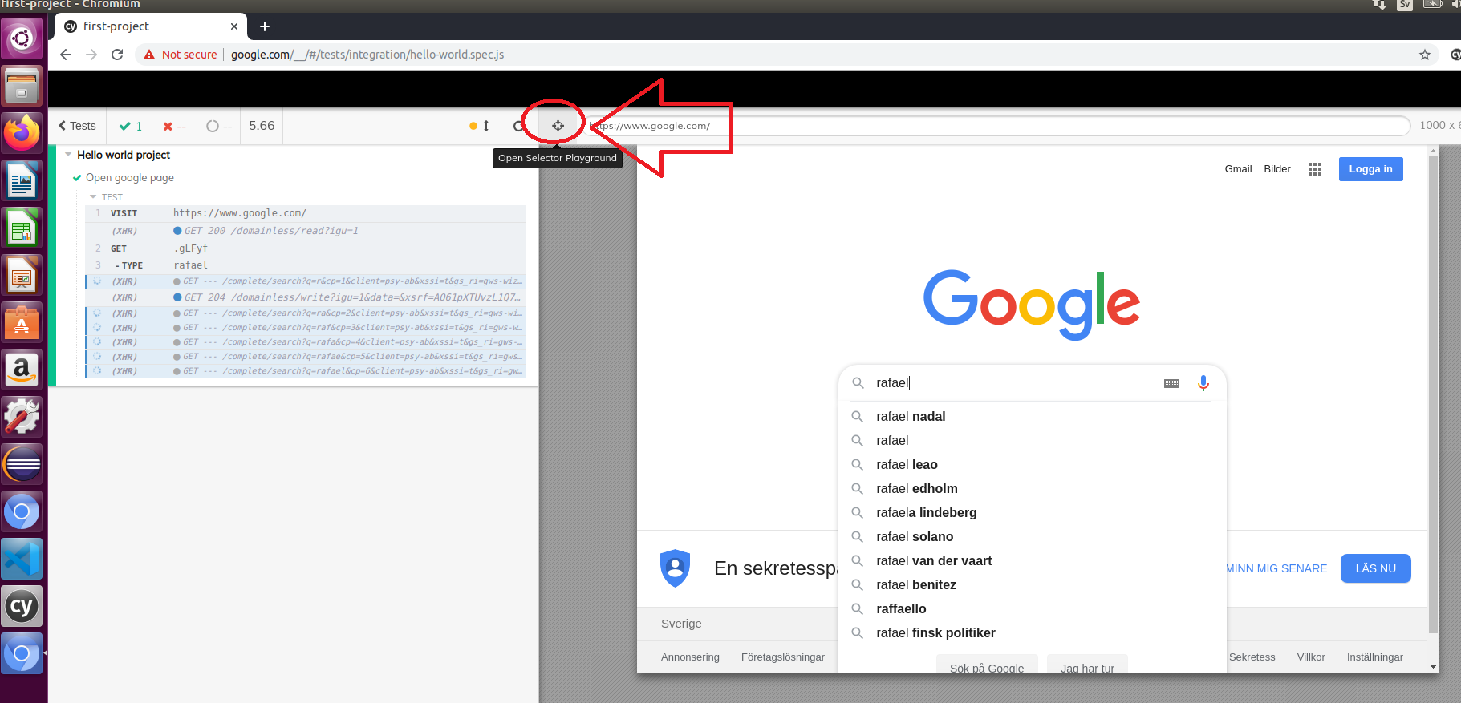
Introduction to css selectors
Getting help from cypress desktop application.

Slide 9
Cypress.io – Interaction with Elements
Let’s check some of the available commands, for interacting with elements, on the link below:
https://docs.cypress.io/guides/core-concepts/interacting-with-elements.html#Actionability

Slide 10
Cypress.io – Commands
Let’s check some other available commands on the link below:
https://docs.cypress.io/api/commands/and.html#Syntax

Slide 11
Cypress.io - Assertions
Let’s check some of the available assertions on the link below:
https://docs.cypress.io/guides/references/assertions.html#TDD-Assertions

Slide 12
Setting-up Nodejs, Chrome & VSC
Install nodejs on Ubuntu.
sudo apt-get install curl
curl -sL https://deb.nodesource.com/setup_12.x | sudo -E bash -
sudo apt-get install nodejs
Install chrome version 64 or newer (Alternatively, install chromium)
Install a code editor. My suggestion is to use Visual Studio Code: https://code.visualstudio.com/download

Slide 13
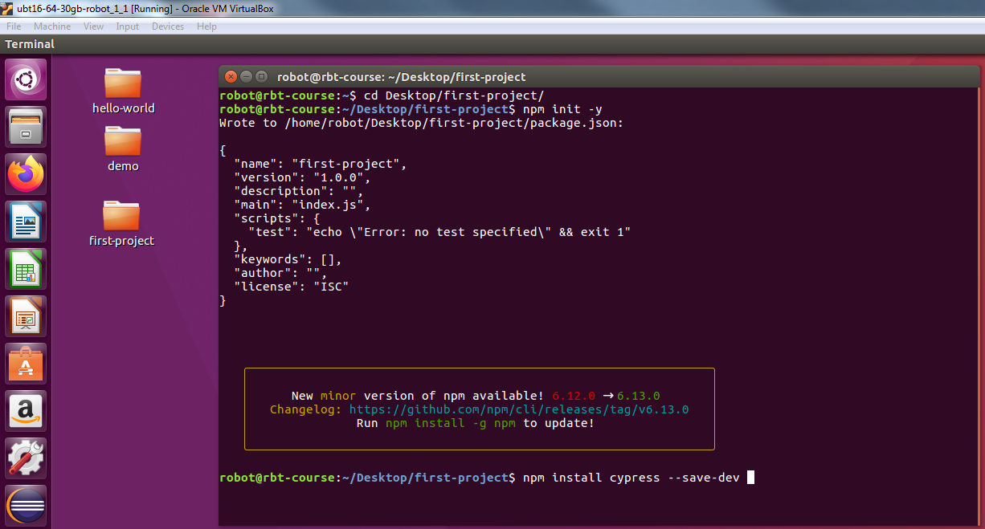
First Project with cypress.io
Steps for setting up the project:
Create a project folder.
Open a terminal and navigate to the created folder.
Run the command: npm init -y
Run the command: npm install cypress --save-dev

Slide 14
First Project with cypress.io
Steps for creating your first test case:
Open the roject folder within Visual Studio Code
Open the file package.json and, under ”scripts”, include the following line ”cypress:open”: ”cypress open”,
In the terminal, from the root folder of the project, run the command: npm run cypress:open

Slide 15
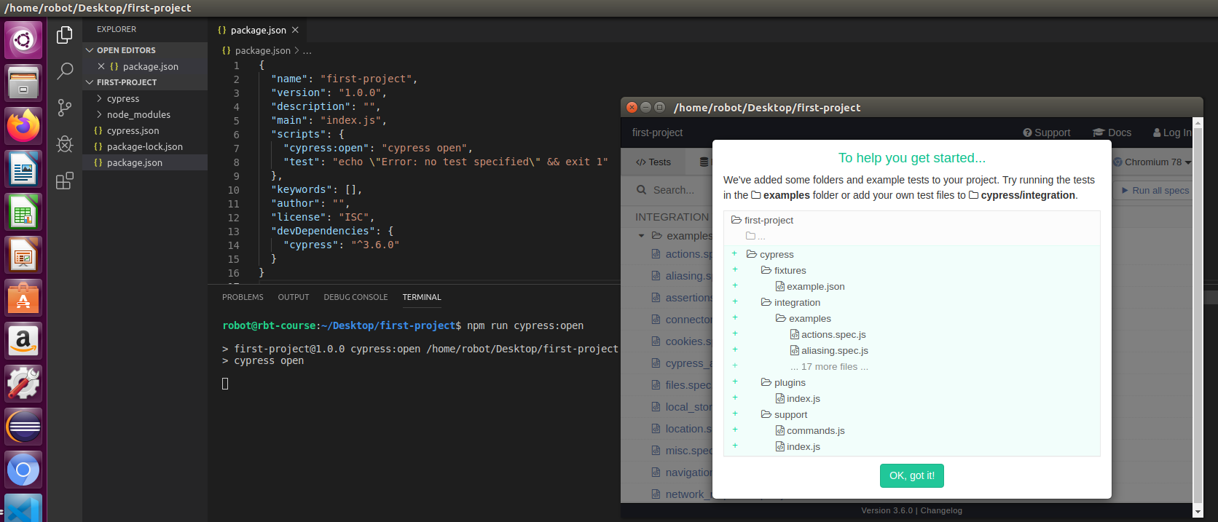
First Project with cypress.io
Steps for creting your first test case:

Slide 16
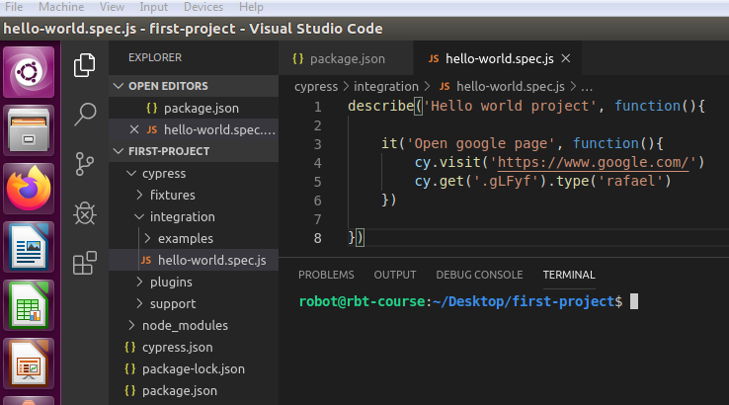
First Project with cypress.io
Steps for creating your first test case:
Now close the cypress desktop application
Create a file under the folder cypress/integration/ called hello-world.spec.js and include the following content:

Slide 17
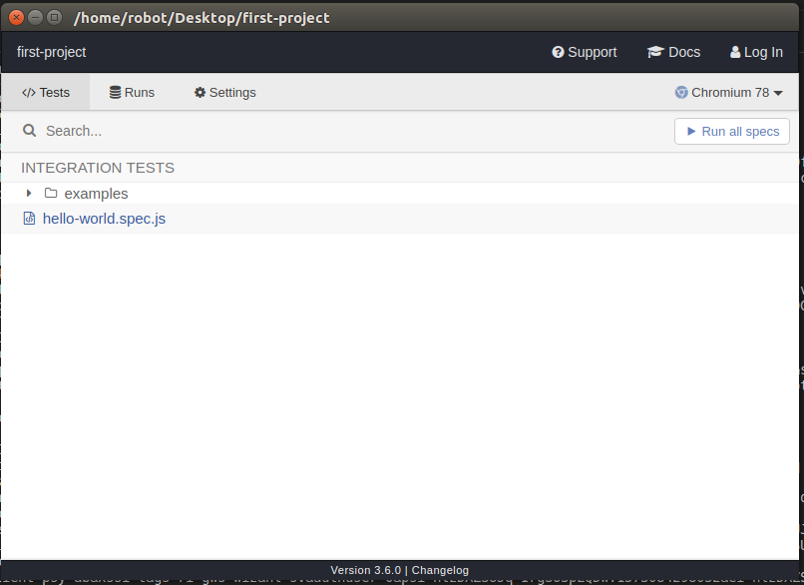
First Project with cypress.io
Running the project on the browser:
In the terminal, run the command npm run cypress:open
Select (click) the test suite hello-world.spec.js and see it running.

Slide 18
First Project with cypress.io
Configuring the cypress runner for running tests on a headless browser:
Open the file package.json and under scripts, include the text: ”cypress:run”: ”cypress run --spec cypress/integration/hello-world.spec.js”,
In the terminal, run the command npm run cypress:run

Slide 19
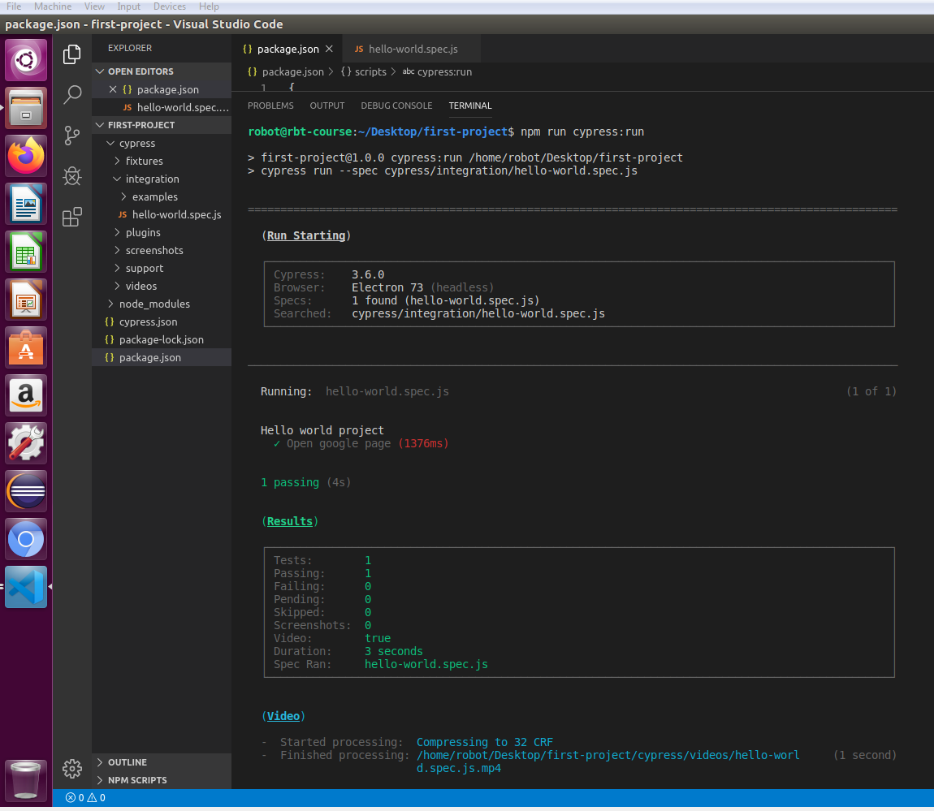
First Project with cypress.io
OBS: Note that a folder called video was generated under /cypress. It contains a video with the test run.

Slide 20
References
https://docs.cypress.io/faq/questions/general-questions-faq.html#Is-Cypress-free-and-open-source
https://www.youtube.com/watch?v=pJ349YntoIs
https://www.cypress.io/
https://docs.cypress.io/guides/references/assertions.html#Chai
https://docs.cypress.io/guides/overview/why-cypress.html#In-a-nutshe
https://www.w3schools.com/css/css_selectors.aspll
https://docs.cypress.io/api/commands/and.html#Syntax
https://docs.cypress.io/guides/references/assertions.html#TDD-Assertions
https://docs.cypress.io/guides/core-concepts/interacting-with-elements.html#Actionability

Slide 21
Agenda – day 3
Introduction to Page-objects design pattern.
The Page-objects design pattern in practice.
Exercises

Slide 22
Page-objects - Introduction
Page-Objects is a known design pattern, very popular, within Test Automation of front-end tests.
It reduces considerably risks for code duplication and makes it easier for you to maintain your project.
The basic principle in this pattern is that you will place page-specific locators and actions into separate files.
You create a new layer of code and, thus, abstract the implementation to a more human-readable code on the test suite file.

Slide 23
Page-objects in practice
While applying the Page-objects design pattern, the procedure is simple; for each page in the AUT you will ask yourself which are the web-elements of the page and which actions you can perform on the page.
After that, you create a file for each page. In these files you will define the web-elements and you will implement the actions (as functions) that can be performed on each page.
Finally, you will invoke the defined functions and methods from within the test suite file.

Slide 24
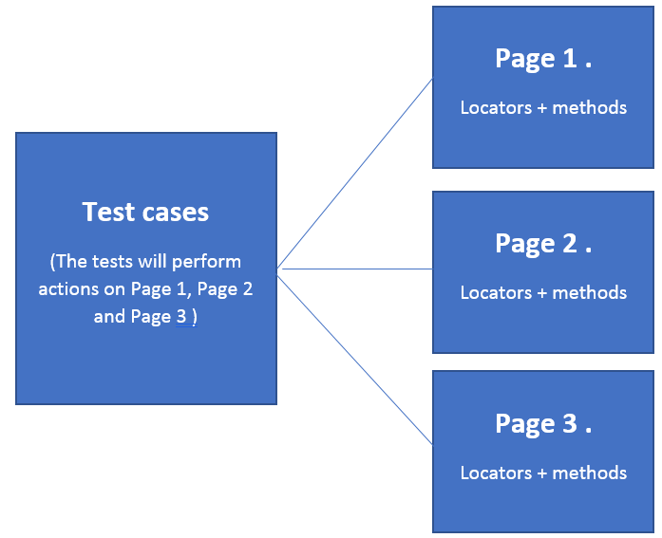
Page-objects - Introduction

Slide 25
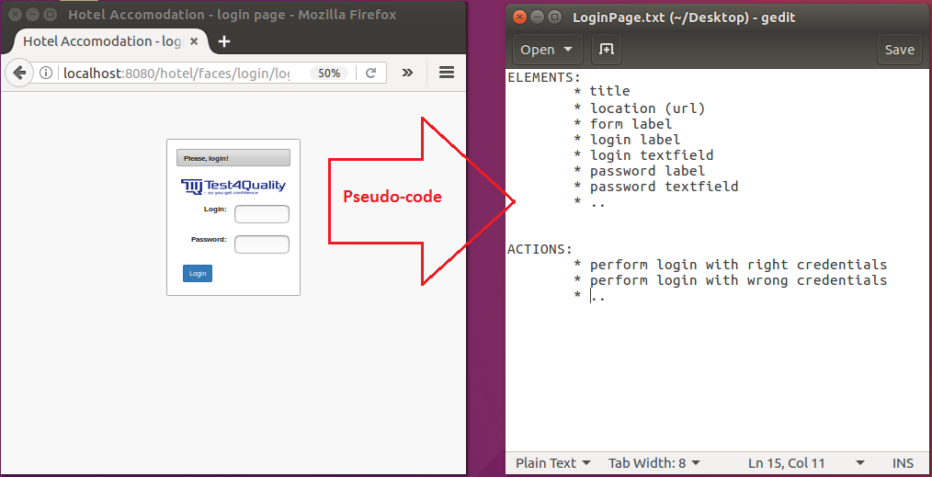
Page-objects – Login page

Slide 26
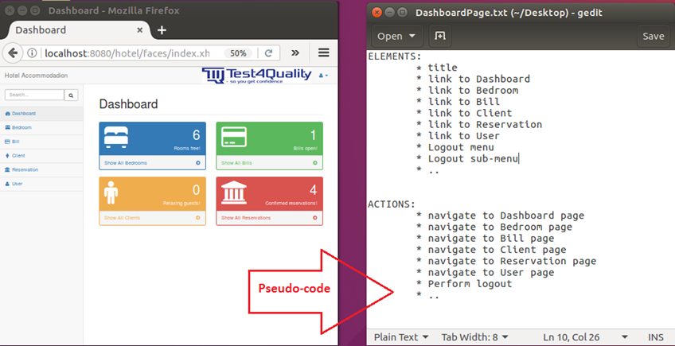
Page-objects – Dashboard page

Slide 27
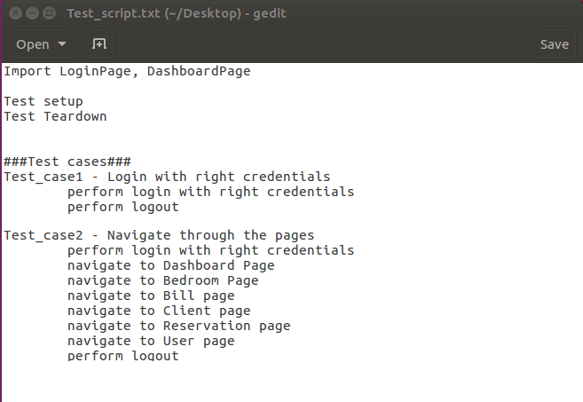
Page-objects – Test script in pseudo-code

Slide 28
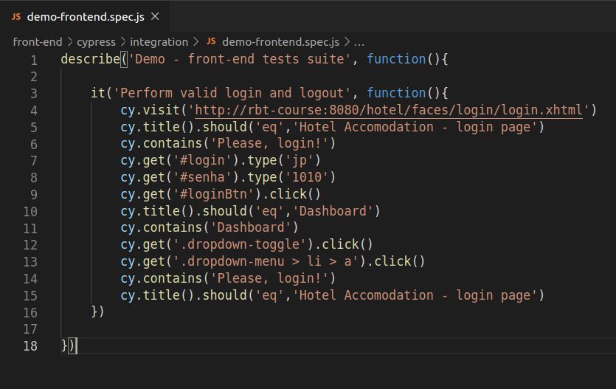
Re-writing the first project
Original test suite

Slide 29
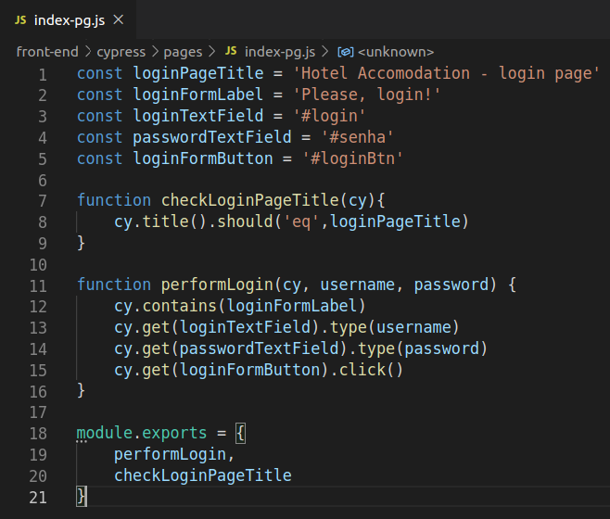
Re-writing the first project
A page object for index page

Slide 30
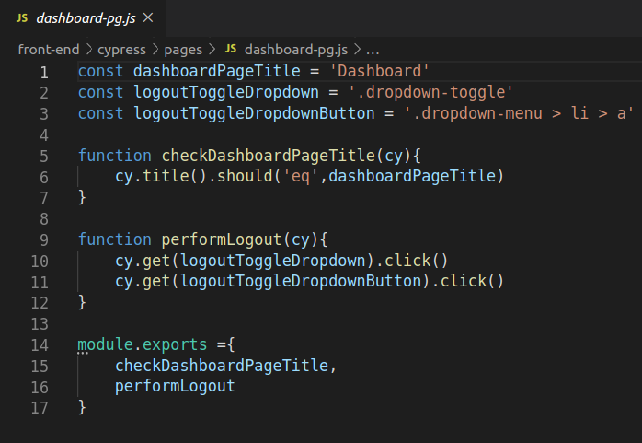
Re-writing the first project
A page object for the dashboard page

Slide 31
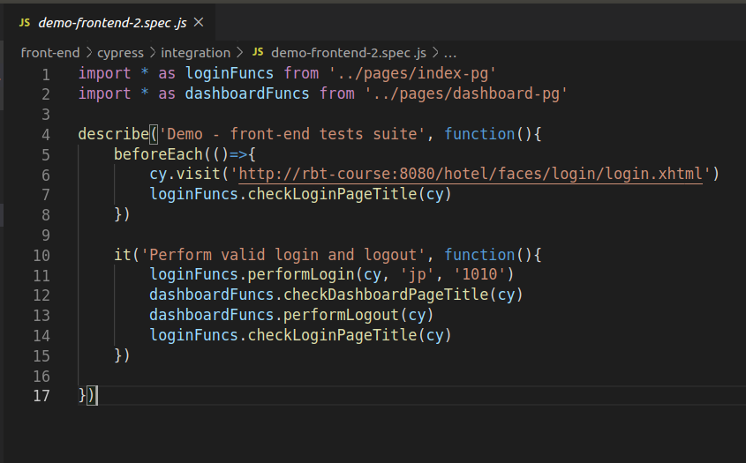
Re-writing the first project
Final test suite file over being re-written

Slide 32
Organizing further your project
Separate credentials, URL:s and other environment variables in seperate files.
Create as many files as you need in your project, but consider creating sub-folders and organizing the files in an intuitive way.
Use comments throughout your source codes.
Log actions performed by methods on the console (Robot Framework has already a very complete built-in logging function when you run your tests)

Slide 33
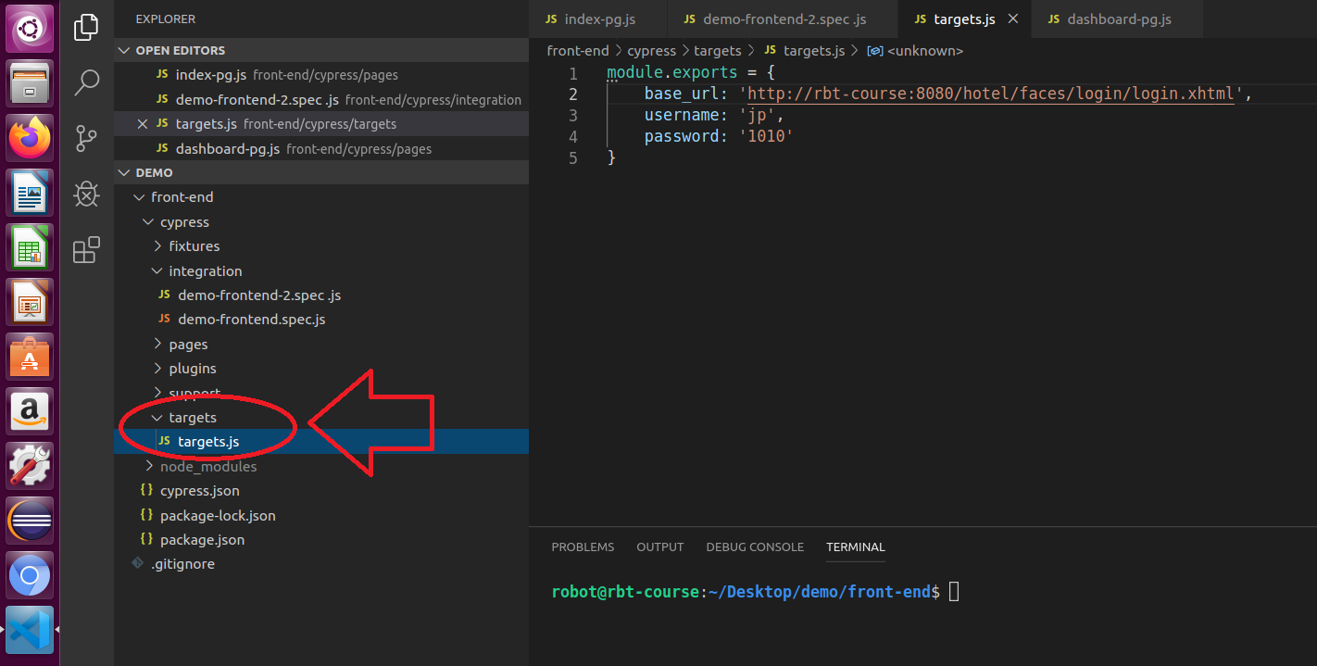
Organizing further your project

Slide 34
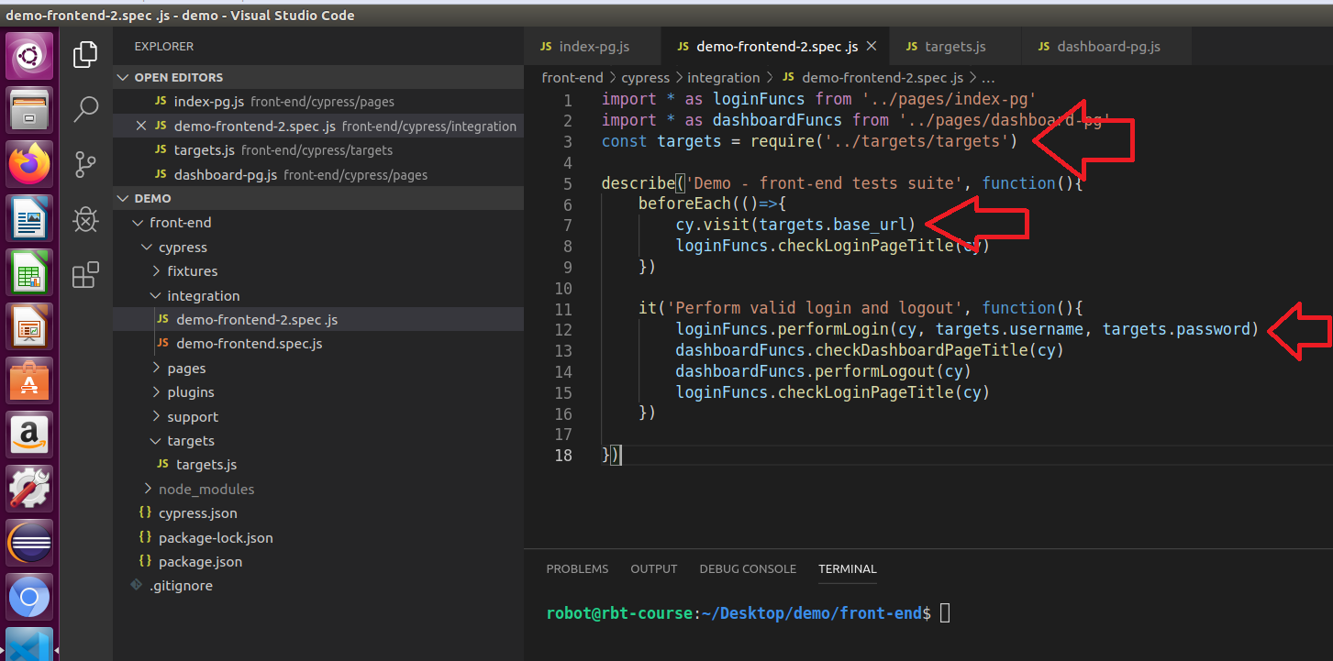
Organizing further your project

Slide 35
Questions?
Notes:
Är din presentation så fräsch som möjligt? Överväg att flytta extra innehåll till bilagan.
Använd bilagesidor för innehåll som du eventuellt vill hänvisa till under frågebilden, eller som kan vara användbart för åhörarna att fördjupa sig i längre fram.

